Slide 1
Lab2 - Sequence-to-Sequence Recurrent Neural Network
Hong-Sheng, Xie
November 3, 2021

Slide 2
Outline
Important Date
Lab Objective
Lab Description
Scoring Criteria
Implement Hints

Slide 3
Important Date
Report Submission Deadline: 11/17 (Wed.) 11:59 a.m.
Demo date: 11/17 (Wed.)
Zip all files into one file
Report (.pdf)
Source code
Name it like「DLP_LAB2_yourID_name.zip」

Slide 4
Lab Objective
In this lab, you need to implement a seq2seq encoder-decoder network with recurrent units for English spelling correction.
English spelling correction:
E.g. 'sicne‘ -> ‘since’

Slide 5
Lab Description
Seq2Seq Model
GRU
Embedding function
Other details

Slide 6
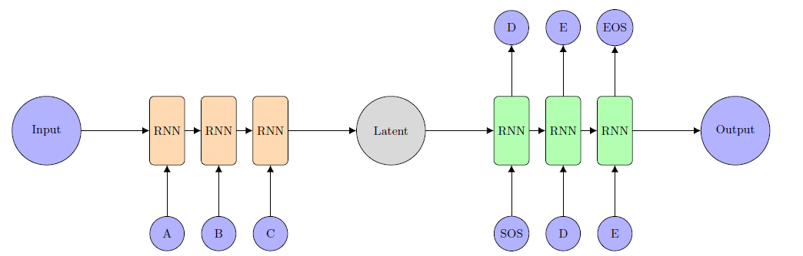
Lab Description - Seq2Seq

Slide 7
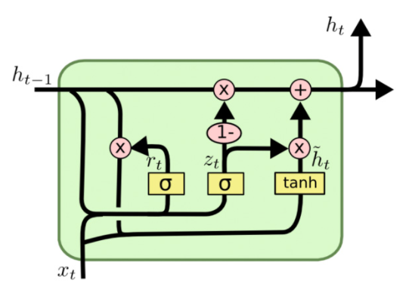
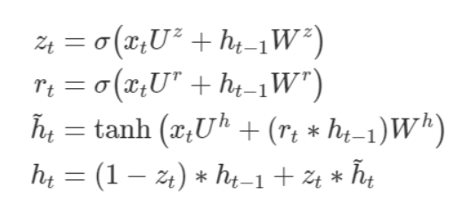
Lab Description - GRU
The encoder and decoder must be implemented by GRU.
You need to implement GRU by yourself. (Don’t use nn.GRU.)

Slide 8
Lab Description -
Embedding function
Since we cannot directly input words into the model, we have to encode words to specific features
Teacher forcing
Using ground truth character instead of the output of the decoder.

Slide 9
Lab Description – Other details
The loss function is nn.CrossEntropyLoss().
The optimizer is SGD
You should not adopt attention mechanism.
Adopt BLEU-4 score function in NLTK.
Average all testing scores

Slide 10
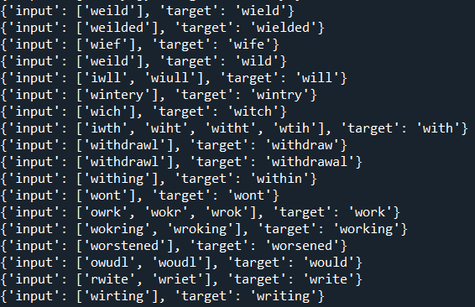
Dataset Description

Slide 11
Lab Description – Requirements
Modify encoder, decoder, and training functions
Implement dataloader and GRU.
Adopt teacher-forcing in your training processing.
Plot the crossentropy loss and BLEU-4 score curve during training.

Slide 12
Scoring Criteria - Report (60%)
Introduction(5%)
Derivation of BPTT(5%)
Implementation details(30%)
Describe how you implement your model. (e.g. dataloader, encoder, decoder, etc)
You must screen shot the code of evaluation part to prove that you do not use ground truth while testing, otherwise you will get no point at this part.
Results and discussion(20%)
Show your results of spelling correction and plot the training loss curve and BLUE-4 score testing curve during training. (10%)
Discuss your results or observation based on your model design or experimental settings. (10%)

Slide 13
Scoring Criteria - Demo(40%)
Classification accuracy on test.json and new_test.json. (10% + 10%)
score >= 0.7 ---- 100%
0.7 > score >= 0.6 ---- 90%
0.6 > score >= 0.4 ---- 80%
score < 0.4 ---- 0%
Questions (20%)

Slide 14
Implement Hints
Pytorch seq2seq tutorial
https://pytorch.org/tutorials/intermediate/seq2seq_translation_tutorial.html

